Slide 1



learn invent impact
Control Flow Aspect of Software
Suresh (Suraj) C. Kothari
Professor, Department of Electrical and Computer Engineering
President & Founder EnSoft Corp.
https://www.linkedin.com/in/surajkothari
Acknowledgement: Team members at Iowa State University and EnSoft, DARPA contracts FA8750- 12-2-0126 & FA8750-15-2-0080

Slide 2
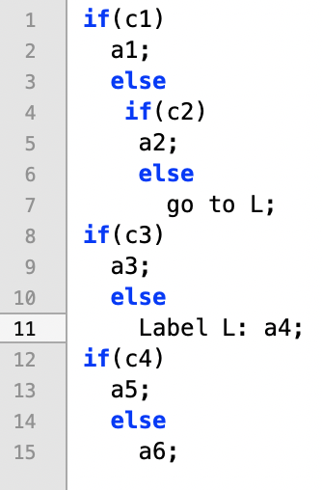
Graph for the successor relation - continuation
n = 4, A = {a1, a2, a3, a4, a5, a6}
Program Statements: {1, 2, 4, 5, 7, 8, 9, 11, 12, 13, 15}
1
2
4
Successor Relation = { (1 2), (1 4), (2 8), (4 5), (4 7), (5 8), (7 11), (8 9), (8 11), (9 12), (11 12), (12 13), (12 15) }
8
12
5
7
9
11
13
15

Slide 3
Graph for the successor relation - continuation
n = 4, A = {a1, a2, a3, a4, a5, a6}
Program Statements: {1, 2, 4, 5, 7, 8, 9, 11, 12, 13, 15}
1
2
4
Successor Relation = { (1 2), (1 4), (2 8), (4 5), (4 7), (5 8), (7 11), (8 9), (8 11), (9 12), (11 12), (12 13), (12 15) }
7
8
5
9
11
12
13
15

Slide 4
Graph for the successor relation - continuation
n = 4, A = {a1, a2, a3, a4, a5, a6}
Program Statements: {1, 2, 4, 5, 7, 8, 9, 11, 12, 13, 15}
1
2
4
Successor Relation = { (1 2), (1 4), (2 8), (4 5), (4 7), (5 8), (7 11), (8 9), (8 11), (9 12), (11 12), (12 13), (12 15) }
7
8
5
9
11
12
13
15

Slide 5
Inefficient way
Program
Truth Table representing all execution behaviors
Compact Representation
of execution behaviors
Efficient way
Program
Successor Relation
Compact Representation
of execution behaviors

Slide 6
Intra-procedural Control: the control within a function – we may call it micro control
Inter-procedural Control: the control across functions – we may call it macro control
We will study macro control later

